Slide 1
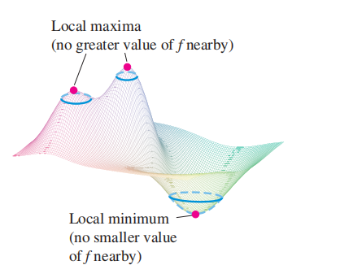

14.7 Extreme Values and Saddle Points

Slide 2

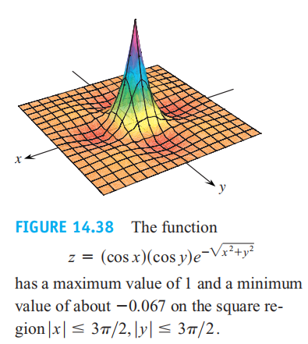
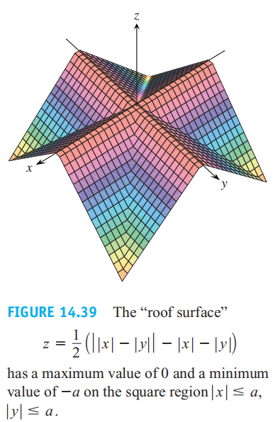

Slide 3


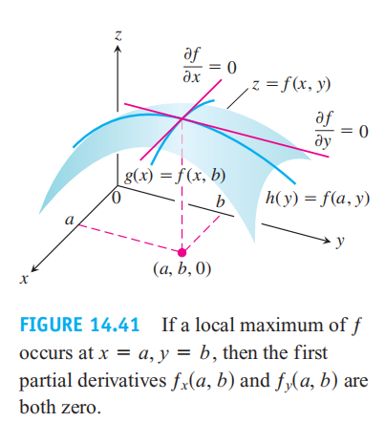

Slide 4

Theorem 10 says that the surface does indeed have a
horizontal tangent plane at a local extremum, provided there is a tangent plane there.
Theorem 10 says that the only points where a function ƒ(x, y) can assume extreme values are critical points and boundary points. Not every critical point gives rise to a local extremum

Slide 5

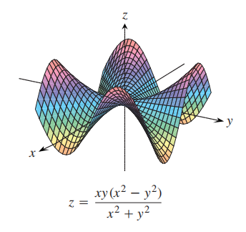
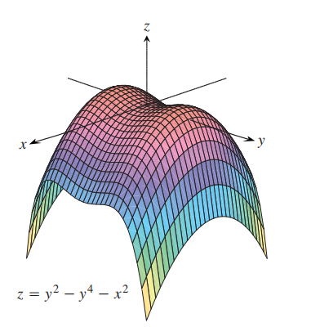

Slide 6
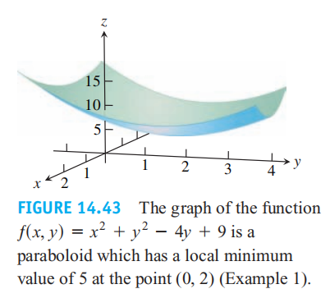

Slide 7
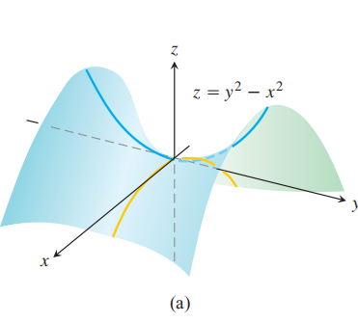

Slide 8
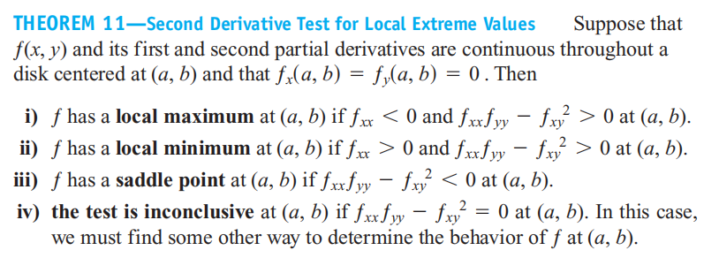


Slide 9


Slide 11
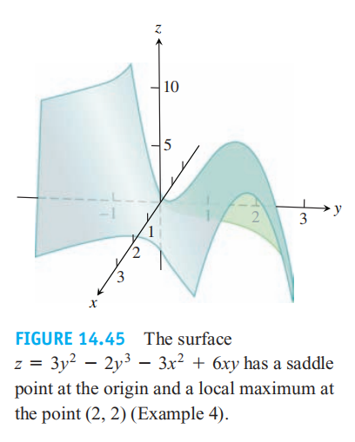

Slide 12


Example: Discuss if and
will take local exteme at (0,0)

Slide 13
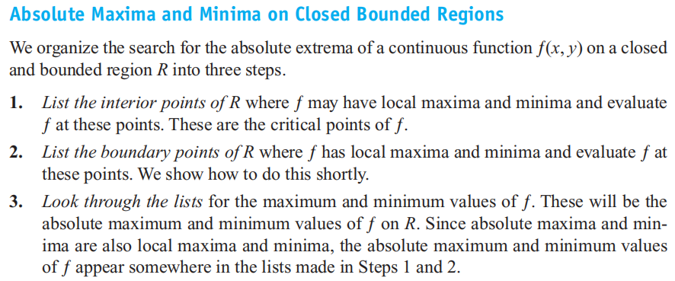

Slide 14


Slide 15

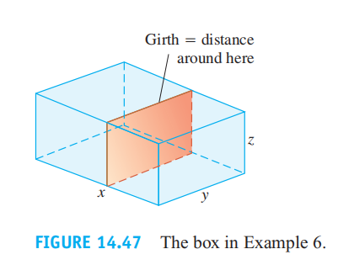

Slide 16
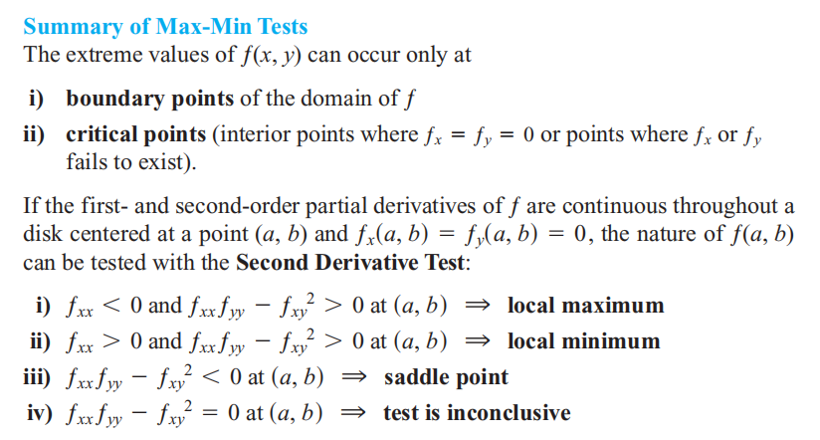

Slide 17

Find the absolute maxima and minima of the functions on the given domains.

Slide 18


